Slide 1
CMSC201 Computer Science I for Majors Lecture 24 – Algorithmic Analysis

Slide 2
Last Class We Covered
Sorting algorithms
Bubble Sort
Selection Sort
Quicksort
Searching algorithms
Linear search
Binary search

Slide 3
Any Questions from Last Time?

Slide 4
Today’s Objectives
To learn about asymptotic analysis
What it is
Why it’s important
How to calculate it
To discuss “run time” of algorithms
Why one algorithm is “better” than another

Slide 5
Alphabetizing a Bookshelf
Video from https://www.youtube.com/watch?v=WaNLJf8xzC4

Slide 6
Run Time

Slide 7
Run Time
An algorithm’s run time is the amount of “time” it takes for that algorithm to run
“Time” normally means number of operations or something similar, and not seconds or minutes
Run time is shown as an expression, which updates based on how large the problem is
Run time shows how an algorithm scales, or changes with the size of the problem

Slide 8
Example: Fibonacci Recursion
Ideally, we want an algorithm that runs in a reasonable amount of time, no matter how large the problem
Remember the recursive Fibonacci program?
It runs within one second for smaller positions
But the larger the position we ask for, the longer and longer it takes

Slide 9
Fibonacci Recursion
python fibEx.py (with position < 30):
< 1 second
python fibEx.py (with position = 30):
2 seconds
python fibEx.py (with position = 35):
8 seconds
python fibEx.py (with position = 40):
76 seconds

Slide 10
Fibonacci Recursion
python fibEx.py (with position = 50):
Guess!
9,493 seconds
2 hours, 38 minutes, 13 seconds!!!

Slide 11
Run Time for Linear Search
Say we have a list that does not contain what we’re looking for.
How many things in the list does linear search have to look at for it to figure out the item’s not there for a list of 8 things?
16 things?
32 things?

Slide 12
Run Time for Binary Search
Say we have a list that does not contain what we’re looking for.
What about for binary search?
How many things does it have to look at to figure out the item’s not there for a list of 8 things?
16 things?
32 things?
Notice anything different?

Slide 13
Different Run Times
These algorithms scale differently!
Linear search does an amount of work equal to the number of items in the list
Binary search does an amount of work equal to the log₂ of the numbers in the list!
By the way, log₂(x) is basically asking “2 to what power equals x?” (normally shown as lg(x) )
This is the same as saying, “how many times must we divide x in half before we hit 1?”

Slide 14
Bubble Sort Run Time
For a list of size N, how much work do we do for a single pass?
N
How many passes will we have to do?
N
What is the run time of Bubble Sort?
N²

Slide 15
Selection Sort Run Time
What is the run time of finding the lowest number in a list?
For a list of size N, how many elements do you have to look through to find the min?
N

Slide 16
Selection Sort Run Time
For a list of size N, how many times would we have to find the min to sort the list?
N
What is the run time of this sorting algorithm?
N²

Slide 17
Quicksort Run Time
For a list of size N, how many steps does it take to move everything less than the “pivot” to the left and everything greater than the “pivot” to the right?
N

Slide 18
Quicksort Run Time
How many times will the algorithm divide the list in half?
lg(N)
What is the run time of Quicksort?
N * lg(N)

Slide 19
Different Run Times
As our list gets bigger and bigger, which of the search algorithms is faster?
Linear or binary search?
How much faster is binary search?
A lot!
But exactly how much is “a lot”?

Slide 20
Asymptotic Analysis

Slide 21
What is “Big O” Notation?
Big O notation is a concept in Computer Science
Used to describe the complexity (or performance) of an algorithm
Big O describes the worst-case scenario
Big Omega (Ω) describes the best-case
Big Theta (Θ) is used when the best and worst case scenarios are the same

Slide 22
A Simple Example
Say we write an algorithm that takes in an list of numbers and returns the maximum
What is the absolute fastest it can run?
Linear time – Ω(N)
What is the absolute slowest it can run?
Linear time – O(N)
Are these two values the same?
YES – so we can also say it’s Θ(N)

Slide 23
Simplification
We are only interested in the growth rate as an “order of magnitude”
As the problem grows really, really, really large
We are not concerned with the fine details
Constant multipliers are dropped
So O(3 * N²) becomes simply O(N²)
Lower order terms are dropped
So O(N³ + 4N²) becomes simply O(N³)

Slide 24
Asymptotic Analysis
For a list of size N, linear search does N operations. So we say it is O(N) (pronounced “big Oh of n”)
For a list of size N, binary search does lg(N) operations, so we say it is O(lg(N))
The function inside the O() parentheses indicates how fast the algorithm scales

Slide 25
Worst Case vs Best Case
Why differentiate between the two?
Think back to selection sort
What is the best case for run time?
What is the worst case for run time?
They’re the same!
Always have to find each minimum by looking through the entire list every time – Θ(N²)

Slide 26
Bubble Sort Run Times
What about bubble sort?
What is the best case for run time?
What is the worst case for run time?
Very different!
Best case, everything is already sorted – Ω( N )
Worst case, it’s completely backwards – O( N² )

Slide 27
Quicksort Run Times
What about quicksort?
Depends on what the “hinge” or “pivot” is
This determines how many times we split
But each split, we’ll need to compare each item to the hinge in their respective part: O( N )
Best case, pivot is exact center – Ω( N*lgN )
Worst case, it’s an “edge” item – O( N² )

Slide 28
Worst-case vs Best-case
This is why, even though all three sorting algorithms have the same run times...
Quicksort often runs very, very quickly
Bubble Sort often runs much faster than Selection
How does this apply to linear search and binary search? What are the best and worst run times for these?

Slide 29
Search Run Times
Linear search:
Best case: Ω( 1 )
Worst case: O( N )
Binary search:
Best case: Ω( 1 )
Worst case: O( lg(N) )

Slide 30
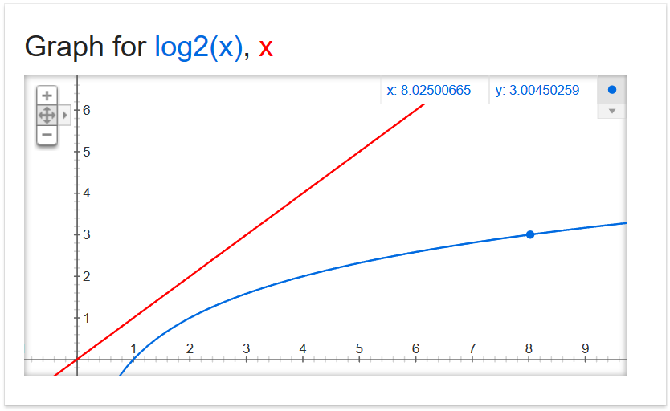
Why Care?

Slide 31
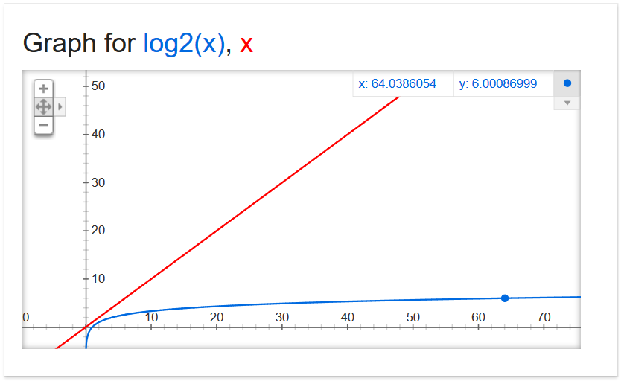
Why Care?

Slide 32
Why Care?

Slide 33
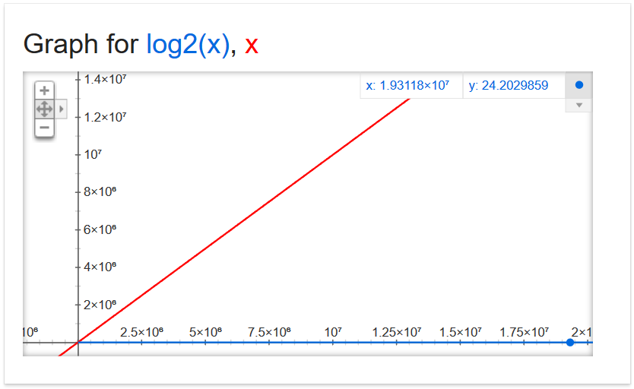
Why Care?
19,311,800

Slide 34
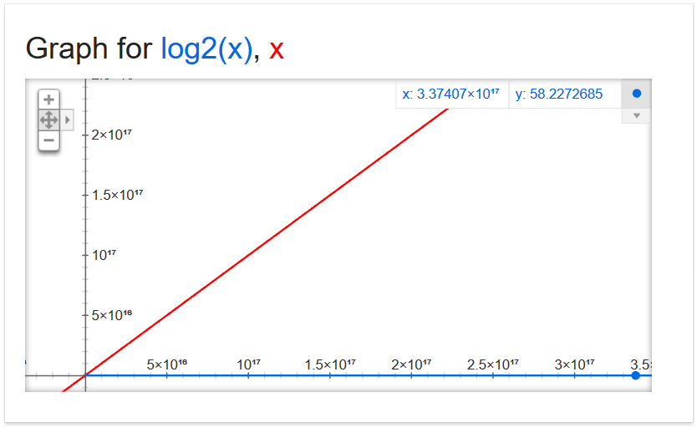
Why Care?
337,407,000,000,000,000

Slide 35
Why Care?
For large problems, there’s a huge difference!
If we can do 1,000,000 operations per second, and the list is 337.4 quadrillion items
Binary search takes 0.000058 seconds
Linear search takes 337,407,000,000 seconds
5,623,450,000 minutes
93,724,166 hours
3,905,173 days
10,699 years

Slide 36
Daily CS History
Hedy Lamarr
Film star in 1930s - 1950s
Patented a frequency-hopping system that would make radio-guided torpedoes hard to detect or jam during World War II
Technologies like Bluetooth and Wi-Fi use similar methods

Slide 37
Announcements
Project 3 is due on Friday, December 8th
Survey #3 due on Tuesday, December 12th
If completed, will receive an email with responses
SEEQs are out now – link in your email/on BB
Final exam is when?
Friday, December 15th from 6 to 8 PM

Slide 38
Completing SEEQs
Please take the time now, if you haven’t already, to complete the SEEQ online
You can access it via the link in your email, or via Blackboard
This is the part → I will get to see

Slide 39
Final Exam Locations
Find your room ahead of time!
ITE Building 102 - Sections 22, 28, 32
ITE Building 104 - Sections 2, 3, 4, 5, 6
Meyerhoff 030 - Sections 8, 9, 10, 11, 12, 14, 17, 18, 20
Performing Arts 132 - Sections 15, 16, 31
Sherman 003 - Sections 23, 26, 29, 30
Public Policy 105 - Sections 21, 24, 27

Slide 40
Image Sources
Alphabetizing a Bookshelf video screenshot:
https://www.youtube.com/watch?v=WaNLJf8xzC4
Graphs of x and log₂(x) courtesy of Google equation grapher
Hedy Lamarr:
https://commons.wikimedia.org/wiki/File:Hedy_lamarr_-_1940.jpg

